Slide 1


JNEC
chh. Sambhaji nagar
PNEUMONIA
DETECTION
Using Machine Learning
TEAM SUDARSHAN

Slide 2

CONTENT
01
ABOUT PNEUMONIA
02
PROBLEM STATEMENT
03
SOLUTION !
04
DEEP INTO TECH
05
SUMMARY
06
HOW IT WORKS?

Slide 3

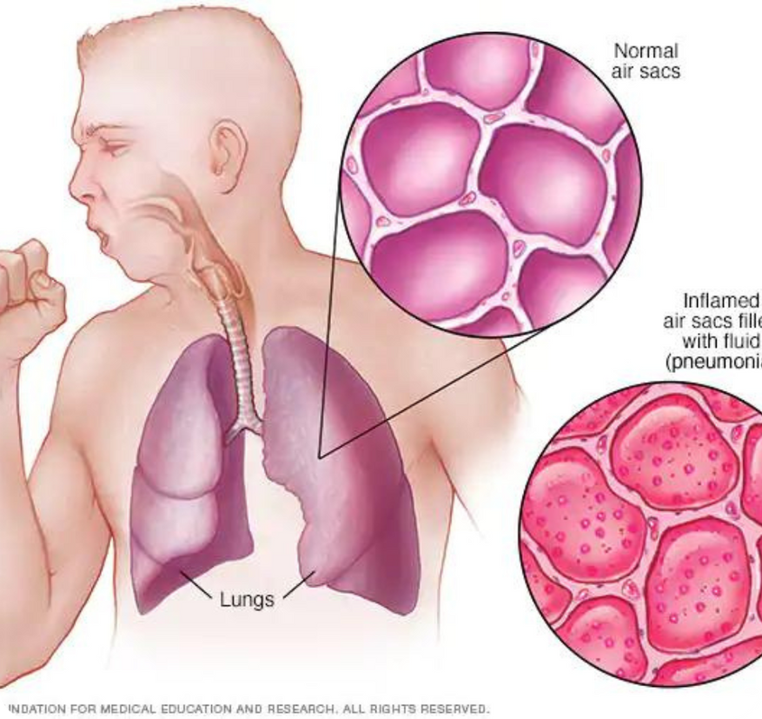
PNEUMONIA
Pneumonia is an infection that inflames the air sacs in one or both lungs. The air sacs may fill with fluid or pus (purulent material), causing cough with phlegm or pus, fever, chills, and difficulty breathing. A variety of organisms, including bacteria, viruses and fungi, can cause pneumonia.

Slide 4

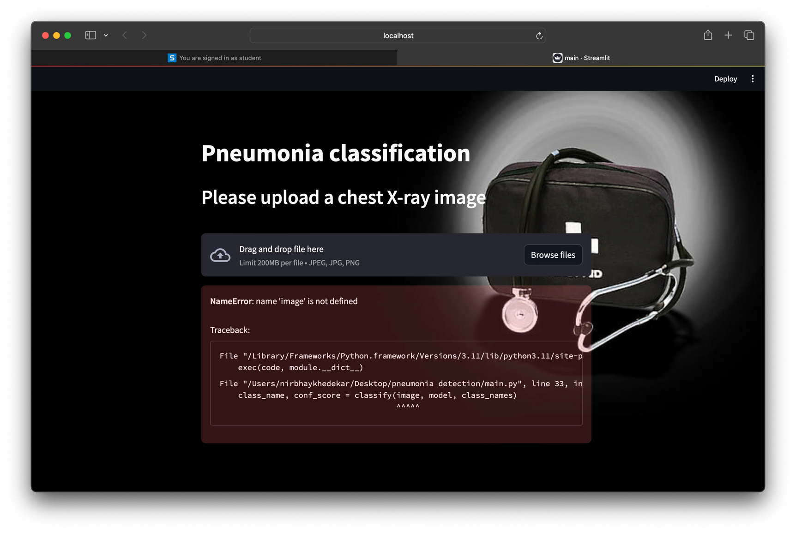
PROBLEM STATEMENT
THERE IS NO CENTRALIZED MONITORING SYSTEM FOR DETECTION OF PNEUMONIA WHICH IS EASILY ACCESSIBLE TO EVERYONE.

Slide 5

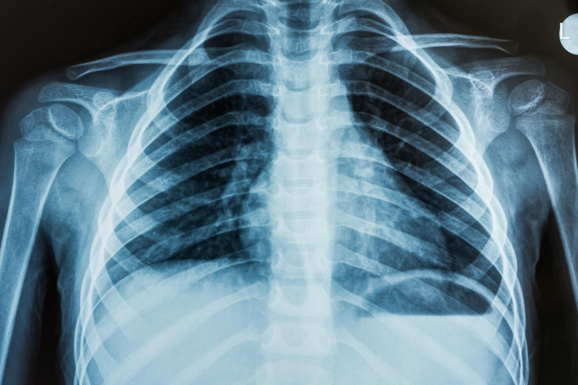

WHY WE NEED?
In today’s time the most effective Pneumonia detection method accepted by the doctors is radiograph. Although, some studies tell us that discrepancies are usual in the interpretation of the chest radiographs via radiologist.
01
This drawback of human based observation has provided enough motivation to technology making interference in this field where machine will classify between a normal X-ray and abnormal Chest X-ray. This provides accuracy and speed to the diagnosis process.
02
Our problem for this project is the “binary Classification” of the input chest X-ray images and then classifies them between the two classes of pneumonia or non?pneumonia.
03

Slide 6



SOLUTION!
Analysis and diagnosis has a major importance in the medical Industry. Timely diagnosis plays a very crucial role whenever lives of the patient are concerned. Pneumonia is sometimes fatal lung infection which can be fatal many times so an early and efficient diagnosis with high accuracy is required. Real life method of detecting pneumonia are very trivial so there is need for a system by using deep-learning has been a driving force for making this project. In this project, we propose different deep convolutional neural network(CNN) architectures to extract features from images of chest X-ray and classify the images to detect presence pneumonia in a person with a higher accuracy. For this research work we have used the real world dataset . Through this project we want to show that with the help of deep learning can help us in detecting disease in early stages which makes it ideal for treatment, which was not possible in the early era of diagnosis.
Objective nº 1
Objective nº 2
Objective nº 3

Slide 7



DEEP INTO TECH
01 Data acquisition
02 Data Preprocessing
03
To begin, a substantial collection of chest X-ray images is gathered. Next, each image is carefully examined and labeled to indicate whether or not pneumonia is present. These extensive datasets are typically sourced from medical facilities, research institutions, or by utilizing publicly accessible platforms such as Kaggle or the NIH Chest X-ray dataset.
Preprocessing steps involve resizing the images to a standard size, normalization, and augmentation techniques to increase the diversity of the dataset. It may also include handling class imbalances if present.
02
01

Slide 8
DEEP INTO TECH
03 Model Architecture
04 Training
03
Designing a deep learning architecture suitable for image classification tasks. Convolutional Neural Networks (CNNs) are commonly used for this purpose due to their effectiveness in extracting features from images. Architectures like ResNet, DenseNet, or custom-designed CNN architectures can be used.
Training the model involves feeding the preprocessed images into the network and adjusting the parameters (weights) iteratively to minimize a chosen loss function, such as binary cross-entropy, which measures the difference between predicted and actual labels.
02
01

Slide 9
DEEP INTO TECH
05 Validation:
06 Hyperparameter Tuning :
03
Validating the model on a separate dataset (validation set) to assess its performance and prevent overfitting. This step involves monitoring metrics like accuracy, precision, recall, and F1-score.
Fine-tuning the hyperparameters of the model, such as learning rate, batch size, and optimizer choice, to improve its performance.
01

Slide 10
DEEP INTO TECH
07 Evaluation:
08 Deployment::
03
Evaluating the trained model on a hold-out test set that the model has never seen before. This step provides an unbiased estimate of the model's performance on unseen data.
Deploying the trained model into production, which may involve integrating it into a healthcare system or application for real-time pneumonia detection.
01

Slide 11





Summary
Overall, the process of pneumonia detection using deep learning involves a combination of data collection, preprocessing, model training, evaluation, and deployment stages, with careful attention to technical details and ethical considerations.

Slide 12

BUT HOW
ITS WORK?

Slide 13

Frontend

Slide 14
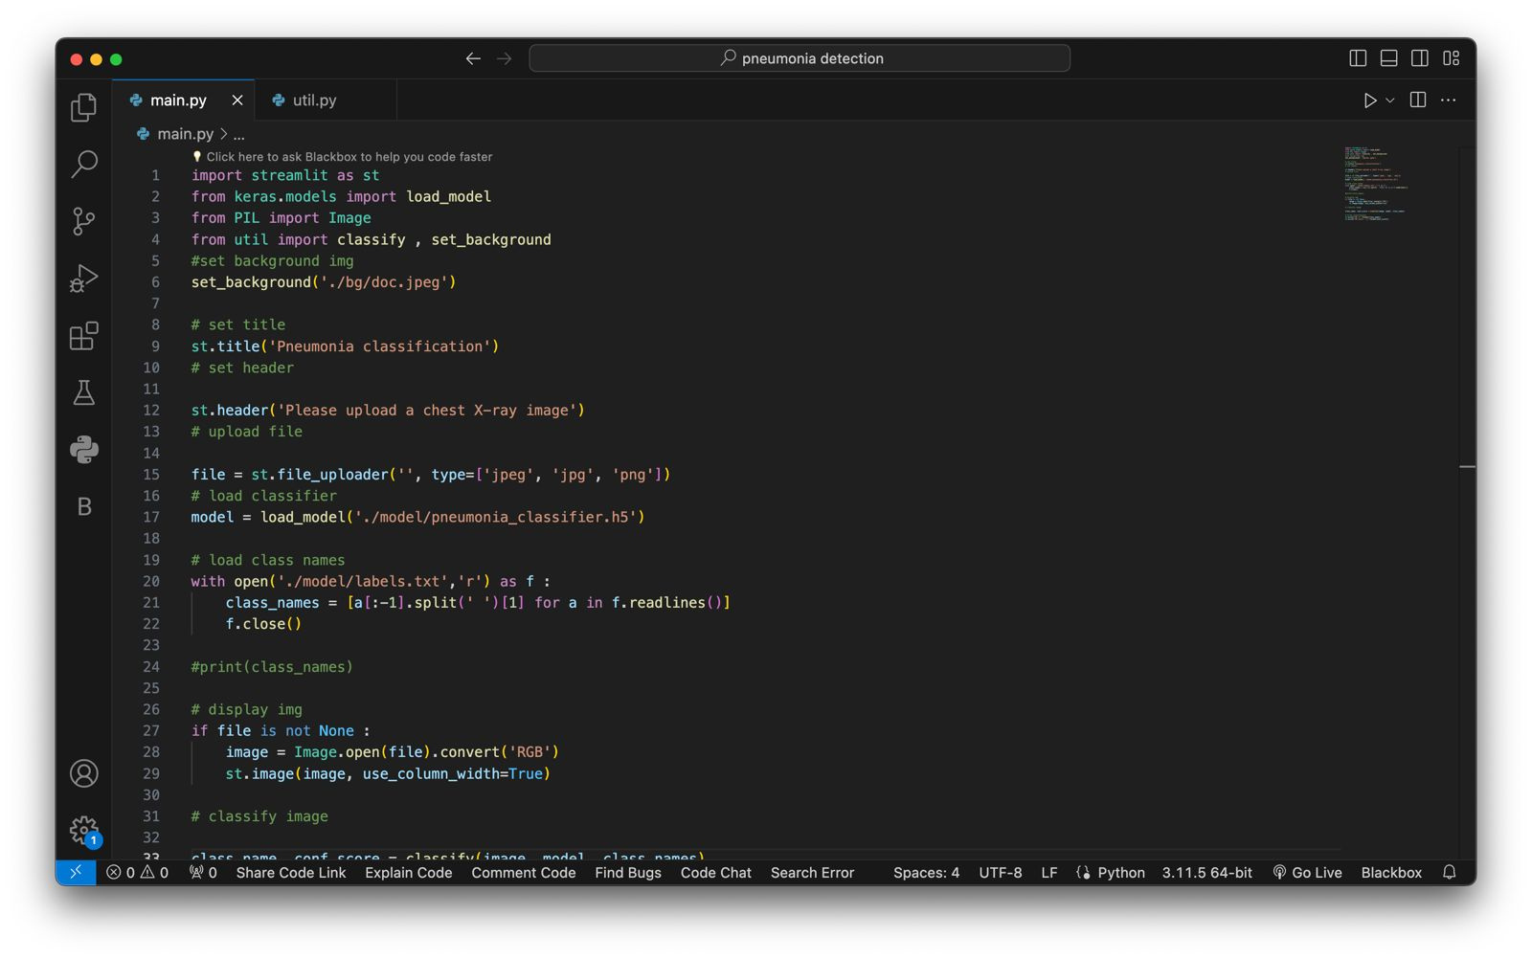
Frontend

Slide 15
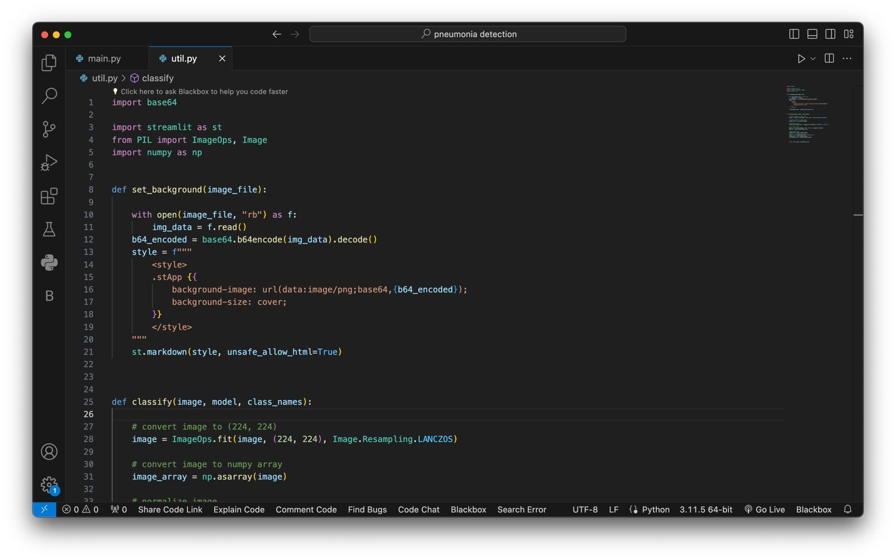
Backend

Slide 16


Let’s demonstrate

Slide 17
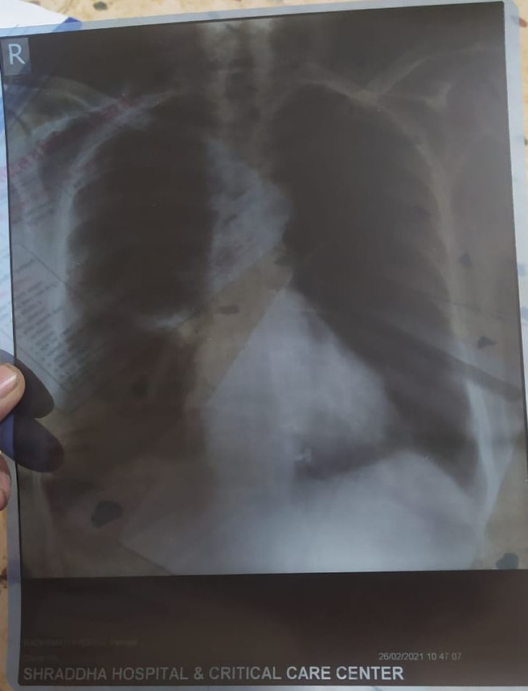
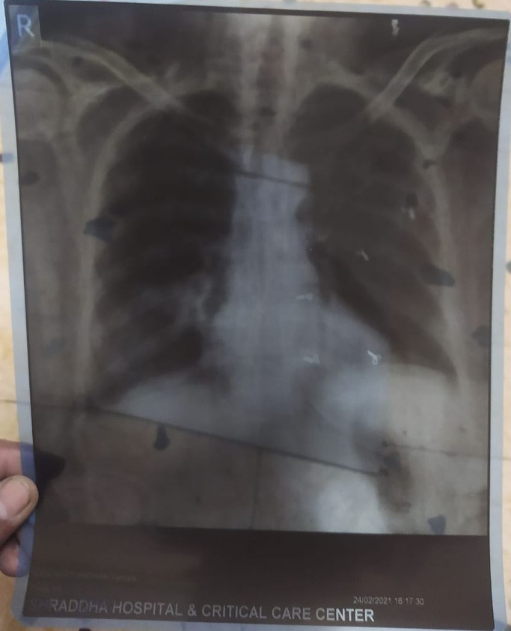
Pneumonia X-ray Reports From Shraddha Hospital,Chh Sambhaji nagar
NORMAL
Pneumonia

Slide 18
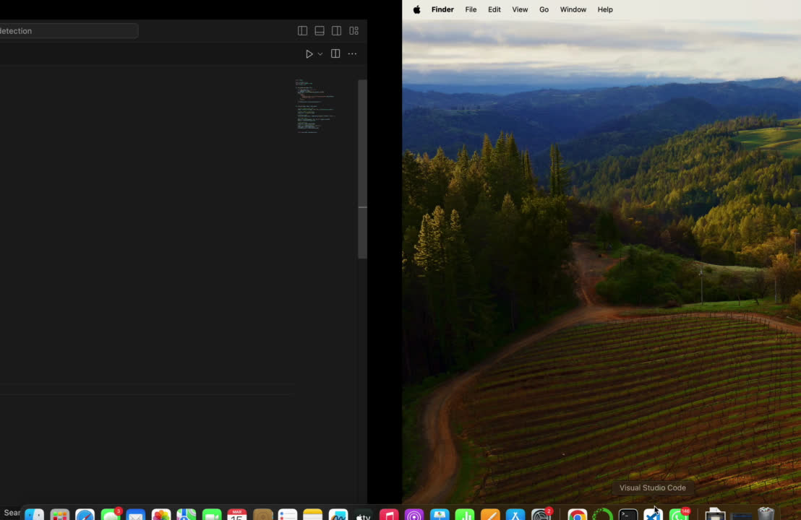

Slide 19
TEAM MEMBER
1.NIRBHAY KHEDEKAR
2.KALPIT KATHAR
3.RITURAJ WAGH
4.SNEHA PATIL

Slide 20

THANK
YOU

